Slide 1
Computer Architecture Project
Evaluating Branch Prediction Strategies
Lulu Jiang
Ruotian Zhang
Junjie Feng

Slide 2
Simplescalar
Simulation platform: Simplescalar simulator
Benchmarks: SPEC95 benchmark suites
In our project, we choose these benchmark:
1) apsi 2) ijpeg 3) perl 4) tomcatv 5) cc1 6) vortex

Slide 3
The default branch prediction strategies in Simplescalar
Taken: predict all the branches will be taken.
Not-Taken: predict all the branches will be not taken.
Bimod: 1) use a branch history table, which contains 2048 entries. 2) Each entry of has 2-bit counter. 3) Using low-order 11-bit to index the entry.

Slide 4
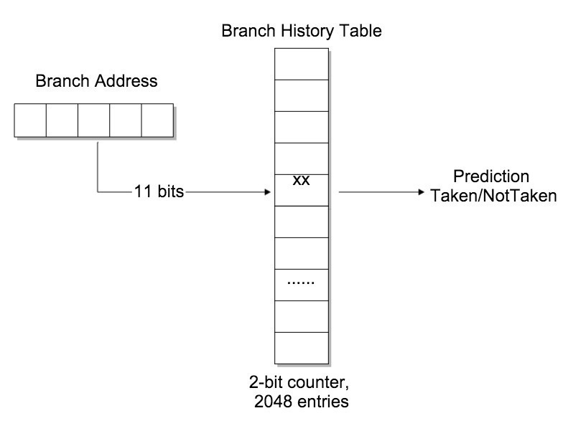
Bimod predictor

Slide 5
Strategy 6 & 7 form the paper
From the paper “A Study of Branch Prediction Strategies”
Strategy 6: similar to bimod strategy
The only difference: each entry has 1-bit counter instead of 2-bit.
Strategy 7: similar to bimod strategy
the only difference: each entry has 3-bit counter instead of 2-bit. If the sign bit is 0, predict as taken, otherwise, predict as not taken.

Slide 6


Strategy 6 & strategy 7

Slide 7
Branch Prediction Results(1)

Slide 8
Strategy 6 & 7 form the paper
Why does the accuracy change?
for(i=0;i<1000;i++)
{ for(j=0;j<100;j++)
{ /*code*/ }
}
For instance, assuming that the initial prediction is not taken. Bimod strategy will only mis-predict one time. However, strategy 6 will miss every time when entry the inner loop.

Slide 9
New Branch Prediction Strategies
2-level adaptive predictor:
1) Each branch has multiple 2-bit predictor, 2) The preceding n branches’ outcomes decide to use which 2-bit predictor.
Some variations of 2-level predictor:
1) Correlating Branch Predictor
2) Gshare Branch Predictor

Slide 10
New Branch Prediction Strategies
Why does the 2 level predictor could get accuracy sometimes?
if (aa == 5)
aa = 0;
if (bb == 5)
bb = 0;
if (aa != bb) {}
The fact that the outcome of the branch depends not only on the branch address but also on the outcome of other recent branches.
Behavior of longer sequence of branch execution history often provides more accurate prediction outcome.

Slide 11
Correlating Branch Prediction
Using global history shift register which contains last 2 branch outcomes.
Low-order 11 bits from branch address is used to choose the pattern history table.
The global history bits is used to index the entry of the pattern history table. Each entry contains 2-bit counters.

Slide 12
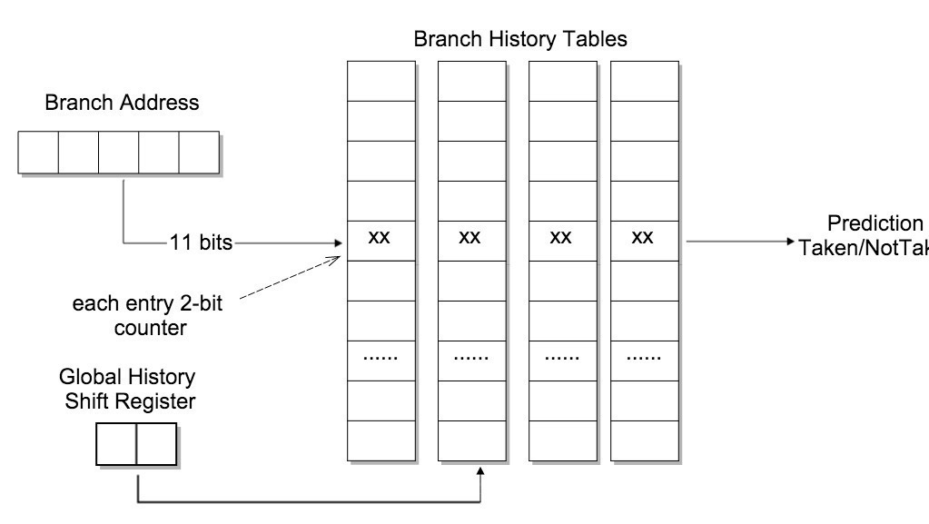
Correlating Branch predictor

Slide 13
Correlating Branch predictor

Slide 14
Issues Affecting Accurate Branch Prediction
Aliasing: More than one branch may use the same Branch History Table entry

Slide 15
Gshare Predictor
Gshare is similar to the correlating branch predictor.
The difference: using the result of low-order 2 bits XOR with 2-bits in the global history register as the index to address the entry.
This strategy could effectively deal with aliasing.

Slide 16
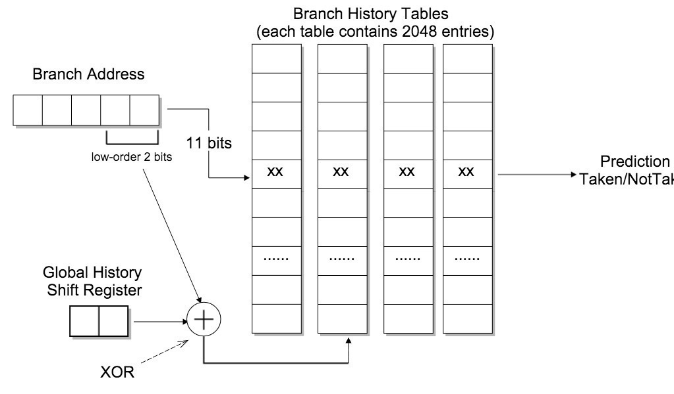
Gshare Predictor

Slide 17
Branch Prediction Results(2)

Slide 18
New Branch Prediction Strategies
Combination branch predictor has two component predictor: bimod predictor and correlating predictor.
Why this strategy could get better accuracy of prediction?
Different branches benefit from different types of history.

Slide 19
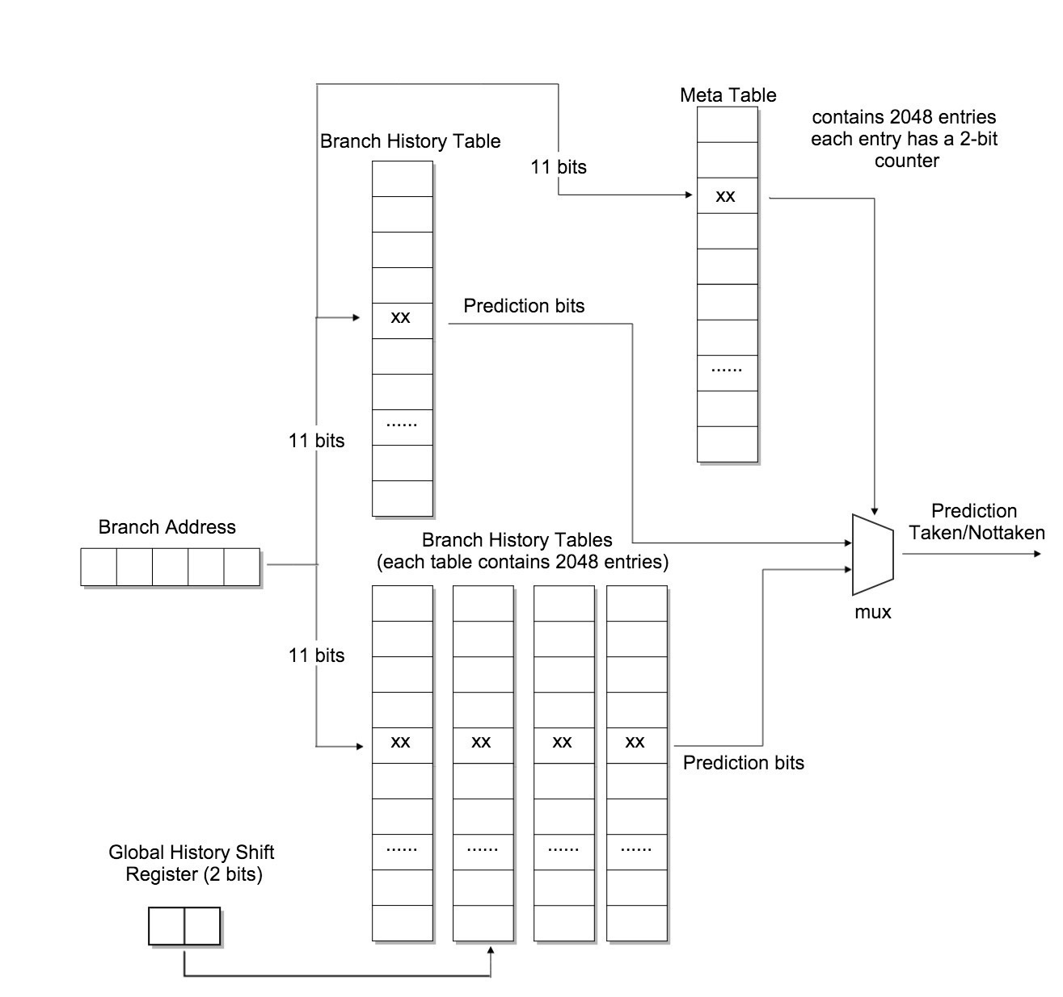
Combination Branch predictor

Slide 20

Combination Branch Predictor
How does this predictor update?
Bimod | Share | Meta table
Correct | Correct | No change
Correct | Incorrect | Increment (+1)
Incorrect | Correct | Decrement (-1)
Incorrect | Incorrect | No change

Slide 21
Branch Prediction Results(3)

Slide 22
Combination Branch predictor
Why does combination predictor could get better performance?
The greater the bits in meta table, the more accuracy of prediction the bimod predictor. Otherwise, the more accuracy of prediction the correlate predictor.

Slide 23
Summary

Slide 24
Thank You

